Slide 1
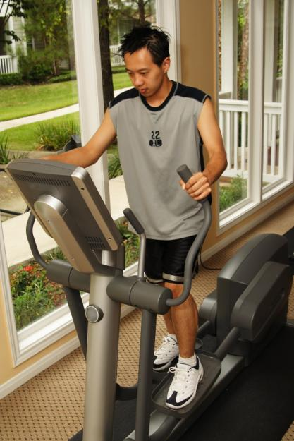
3-10 THE SIMPLE PRESENT: YES/NO QUESTIONS
Does he exercise?
Yes, he does.
Where does he exercise?
He exercises at home.

Slide 2
3-10 THE SIMPLE PRESENT: YES/NO QUESTIONS
(h) Are you a student?
NOT: Do you be a student?
main verb = a form of be
do

Slide 3
3-10 THE SIMPLE PRESENT: YES/NO QUESTIONS
QUESTION SHORT ANSWER
(i) Do you like ice cream?
Yes, I do.
No, I don’t.
(j) Does Max like ice cream?
Yes, he does.
No, he doesn’t.

Slide 4
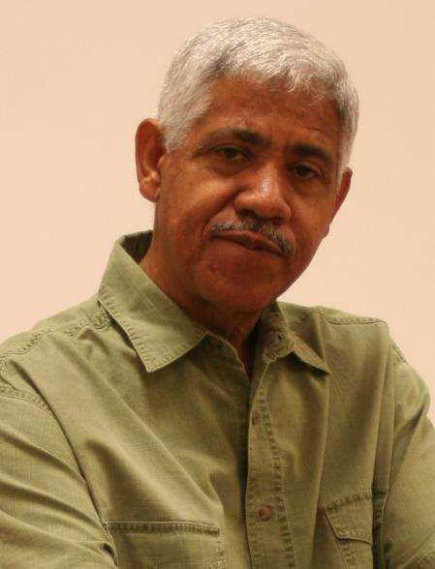
3-10 Let’s Practice
Question
Does Gerardo teach math?
Short Answer
Yes, he does.
Long Answer
Gerardo teaches math.

Slide 5
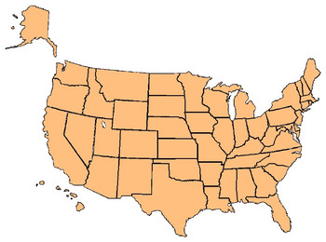
3-11 THE SIMPLE PRESENT: ASKING INFORMATION
QUESTIONS WITH WHERE
Do they live in Baltimore?
Where do they live?
*

Slide 6
3-11 THE SIMPLE PRESENT: ASKING INFORMATION
QUESTIONS WITH WHERE
QUESTION SHORT ANSWER
(a) Do they live in Ñaña?
Yes, they do.
No, they don’t.
(b) Where do they live?
They live in Cañete

Slide 7
3-11 THE SIMPLE PRESENT: ASKING INFORMATION
QUESTIONS WITH WHERE
QUESTION SHORT ANSWER
(c) Does Alexa live in Moscow?
Yes, she does.
No, she doesn’t.
(d) Where does he live?
He lives in New York.

Slide 8
3-11 THE SIMPLE PRESENT: ASKING INFORMATION
QUESTIONS WITH WHERE
(WHERE)
+
+
+
DO/DOES
SUBJECT
MAIN VERB
they
(a) in Surco
Do
live
?
(b) Where
do
they
live
?
(c) in Tarma
Does
Alexa
live
?
he
(d) Where
does
live
?

Slide 9
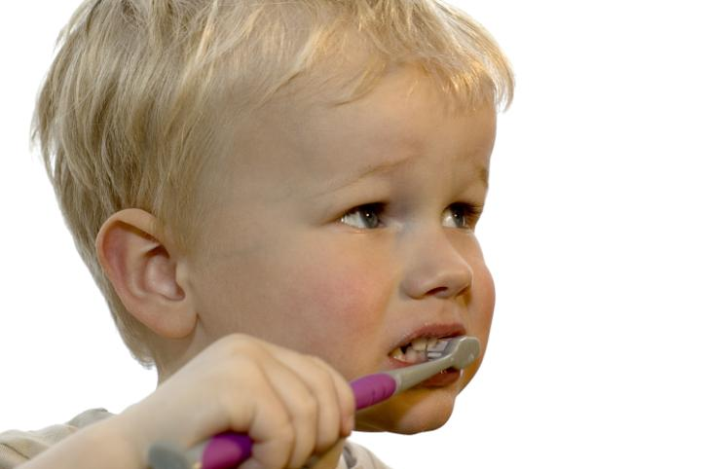
3-11 Let’s Practice
Question:
Answer: Yes, he does.
(The child has a toothbrush.)
Does he have a toothbrush?

Slide 10

3-11 Let’s Practice
Question:
Answer: He brushes his teeth in the bathroom.
Where does he brush his teeth?

Slide 11
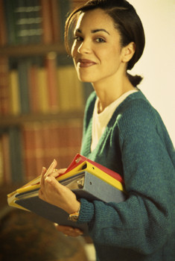
3-11 Let’s Practice
Question:
Answer: Yes, she does.
Does Lucy like to read at the library?
(Lucy likes to read at the library.)

Slide 12
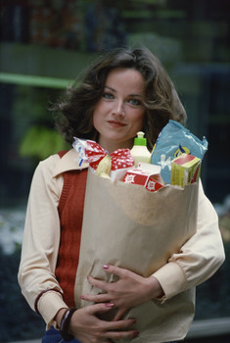
3-12 THE SIMPLE PRESENT: ASKING INFORMATION
QUESTIONS WITH WHEN AND WHAT TIME
When do you go shopping?
What time do you go shopping?

Slide 13
3-12 THE SIMPLE PRESENT: ASKING INFORMATION
QUESTIONS WITH wh-
When do you go shopping?
What do you usually buy?
Where do you go shopping?
Who do you go shopping with?

Slide 14
3-12 THE SIMPLE PRESENT: ASKING INFORMATION
QUESTIONS WITH WHEN AND WHAT TIME
Q-WORD + DO/ + SUBJECT + MAIN
DOES VERB
(a) When do you go to work?
I go to work at eight o’clock.
(b) What time do you go to work?
I go to work at eight o’clock.

Slide 15
3-12 THE SIMPLE PRESENT: ASKING INFORMATION
QUESTIONS WITH WHEN AND WHAT TIME
Q-WORD + DO/ + SUBJECT + MAIN
DOES VERB
(c) When does he exercise?
He exercises at ten o’clock.
(d) What time does he exercise?
He exercises at ten o’clock.

Slide 16
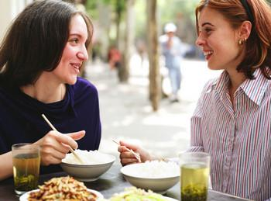
3-12 Let’s Practice
When does the restaurant close?
The restaurant closes at 9:00 P.M.

Slide 17
3-12 Let’s Practice
When do you eat lunch?
I eat lunch at 12:00.

Slide 18
3-12 Let’s Practice
I usually go to bed at 11:00.
When do you go to bed
_____________________?

Slide 19
3-13 SUMMARY: INFORMATION QUESTIONS WITH BE
AND DO
Q-WORD + DO + SUBJECT + MAIN VERB
(f) Where does she live?
She lives in Belgium.
(g) When does school start?
It starts at 9:00 A.M.
(h) What does she play?
She plays tennis.
(i) When do you study?
I study at night.

Slide 20
3-13 Let’s Practice
is are does do
do
Where ____ they buy food?

Slide 21
3-13 Let’s Practice
is are does do
does
What time _____ the train leave?

Slide 22
3-13 Let’s Practice
is are does do
is
When ____ your test?

Slide 23
3-13 Let’s Practice
is are does do
are
What ____ their names?

Slide 24
3-13 Let’s Practice
what when where who
When
______do you have dinner?
I have dinner at nice-thirty at night.

Slide 25
3-13 Let’s Practice
what when where why
Why
_____does he work there?
He works there because the company pays well.

Slide 26
3-13 Let’s Practice
what when where who
What
______do you have for breakfast?
I have juice and toast.

Slide 27
3-13 Let’s Practice
what when where who
Where
______do you work?
I work at ICPNA.

Slide 28
3-13 Let’s Practice
what when where why
Why
_____do you live in Surco?
I live in Surco because it is nice.

Slide 29
3-13 Let’s Practice
what when where who
When
______do you go shopping?
I go shopping on Monday night.

Slide 30
3-13 Let’s Practice
what when where who
What
______do you buy?
I buy tomatoes, lettuce, chicken, juice, soda and onions

Slide 31
3-13 Let’s Practice
what when where who
Where
______do you buy fruits ?
I buy fruits at Wong.

Slide 32
3-13 Let’s Practice
Where do you study?
_______________?
I study at ICPNA.

Slide 33
3-13 Let’s Practice
Where does he live?
______________?
He lives in Ate.

Slide 34
3-13 Let’s Practice
When do you study?
______________?
Carla and I study at 7 a.m.

